Slide 1
Seminar 4
2016/04/22 tran viet cuong

Slide 2
In 2 weeks
PPG, GSR, EMG signal
Buying list
Draft idea about attaching sensors on body
Funny with Backtracking Algorithm (find numbers in binary tree)

Slide 3
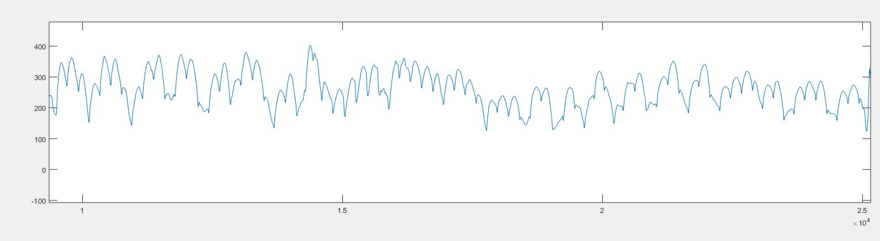
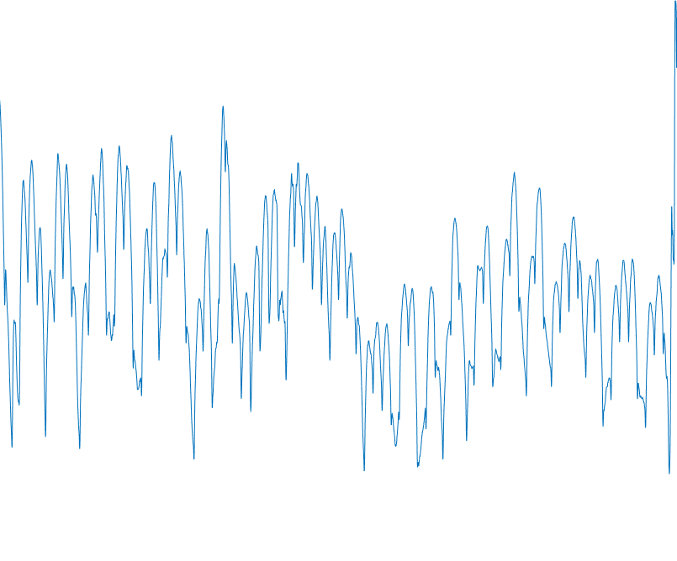
Biomedical signals
PPG signal
EMG signal
GSR signal

Slide 4
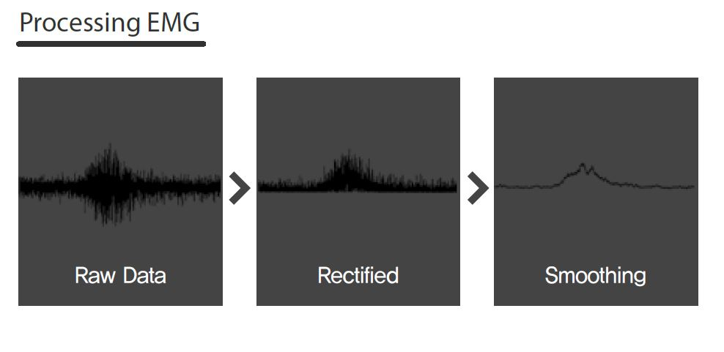
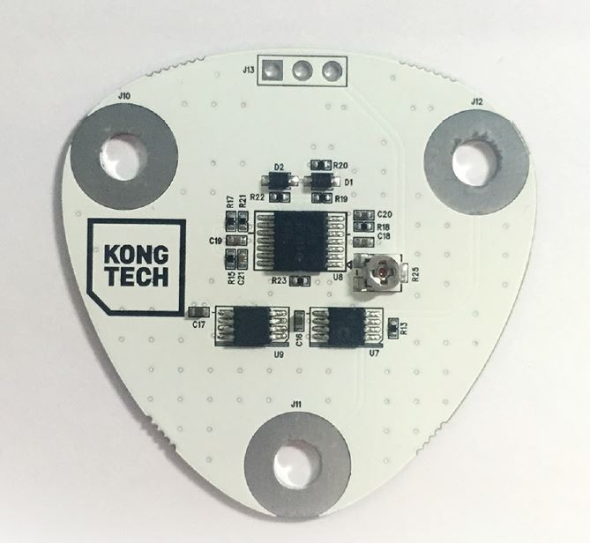
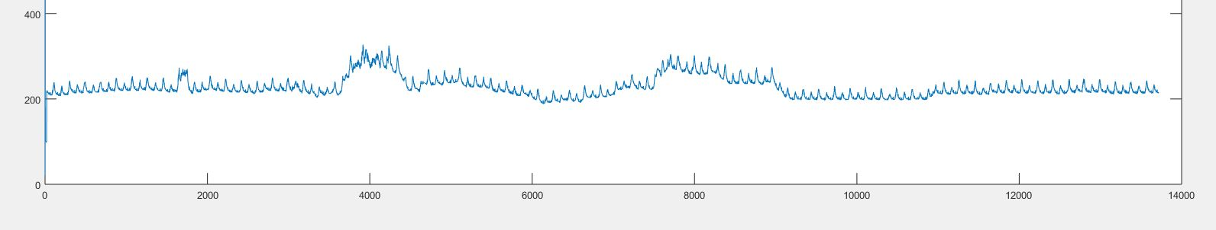
Biomedical signals
PPG signal
EMG signal
GSR signal

Slide 5
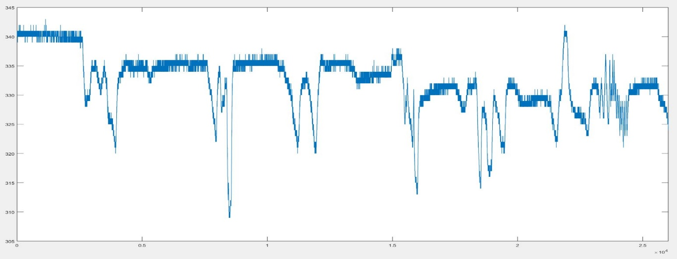
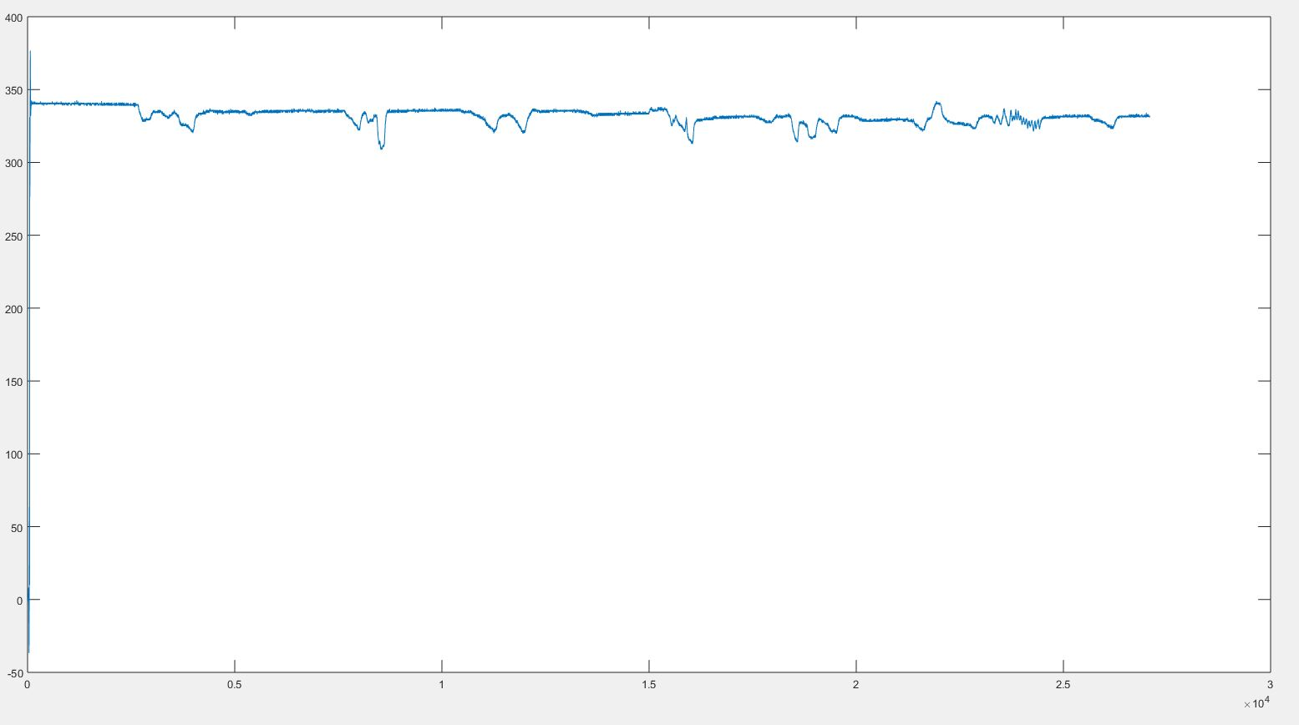
Biomedical signals
PPG signal
EMG signal
GSR signal

Slide 6
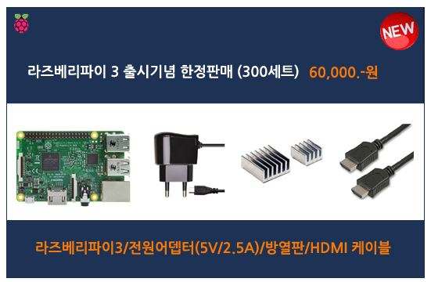
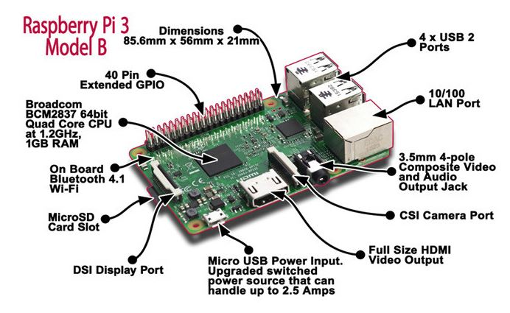

Buying list:
Pi 3 (HDMI, power, micro sd card)
ADS1015(ADC 12 bit, i2c output)
AD8232 (ECG module)
Battery

Slide 7
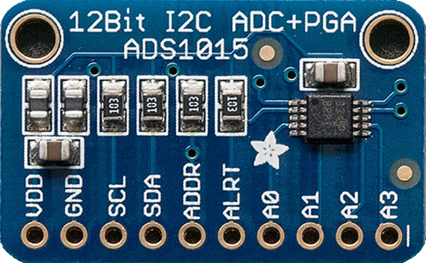
Buying list:
Pi 3 (HDMI, power, micro sd card)
ADS1015(ADC 12 bit, i2c output)
AD8232 (ECG module)
WIDE SUPPLY RANGE: 2.0V to 5.5V
4 ADC Channels 12bit.
LOW CURRENT CONSUMPTION: Continuous Mode: Only 150µA Single-Shot Mode: Auto Shut-Down
I2C INTERFACE: Pin-Selectable Addresses

Slide 8
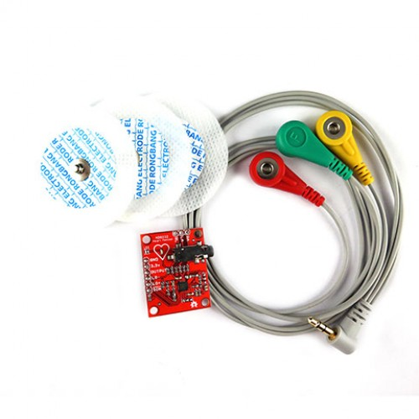
Buying list:
Pi 3 (HDMI, power, micro sd card)
ADS1015(ADC 12 bit, i2c output)
AD8232 (ECG module)
Battery
The AD8232 is an integrated signal conditioning block for ECG and other biopotential measurement applications.
AD8232 Single Lead Heart Rate Monitor acts as an op amp to help obtain a clear signal from the PR and QT Intervals easily.

Slide 9
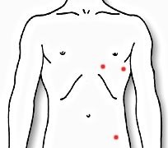
Attaching sensors

Slide 10

Backtracking Algorithm

Slide 11
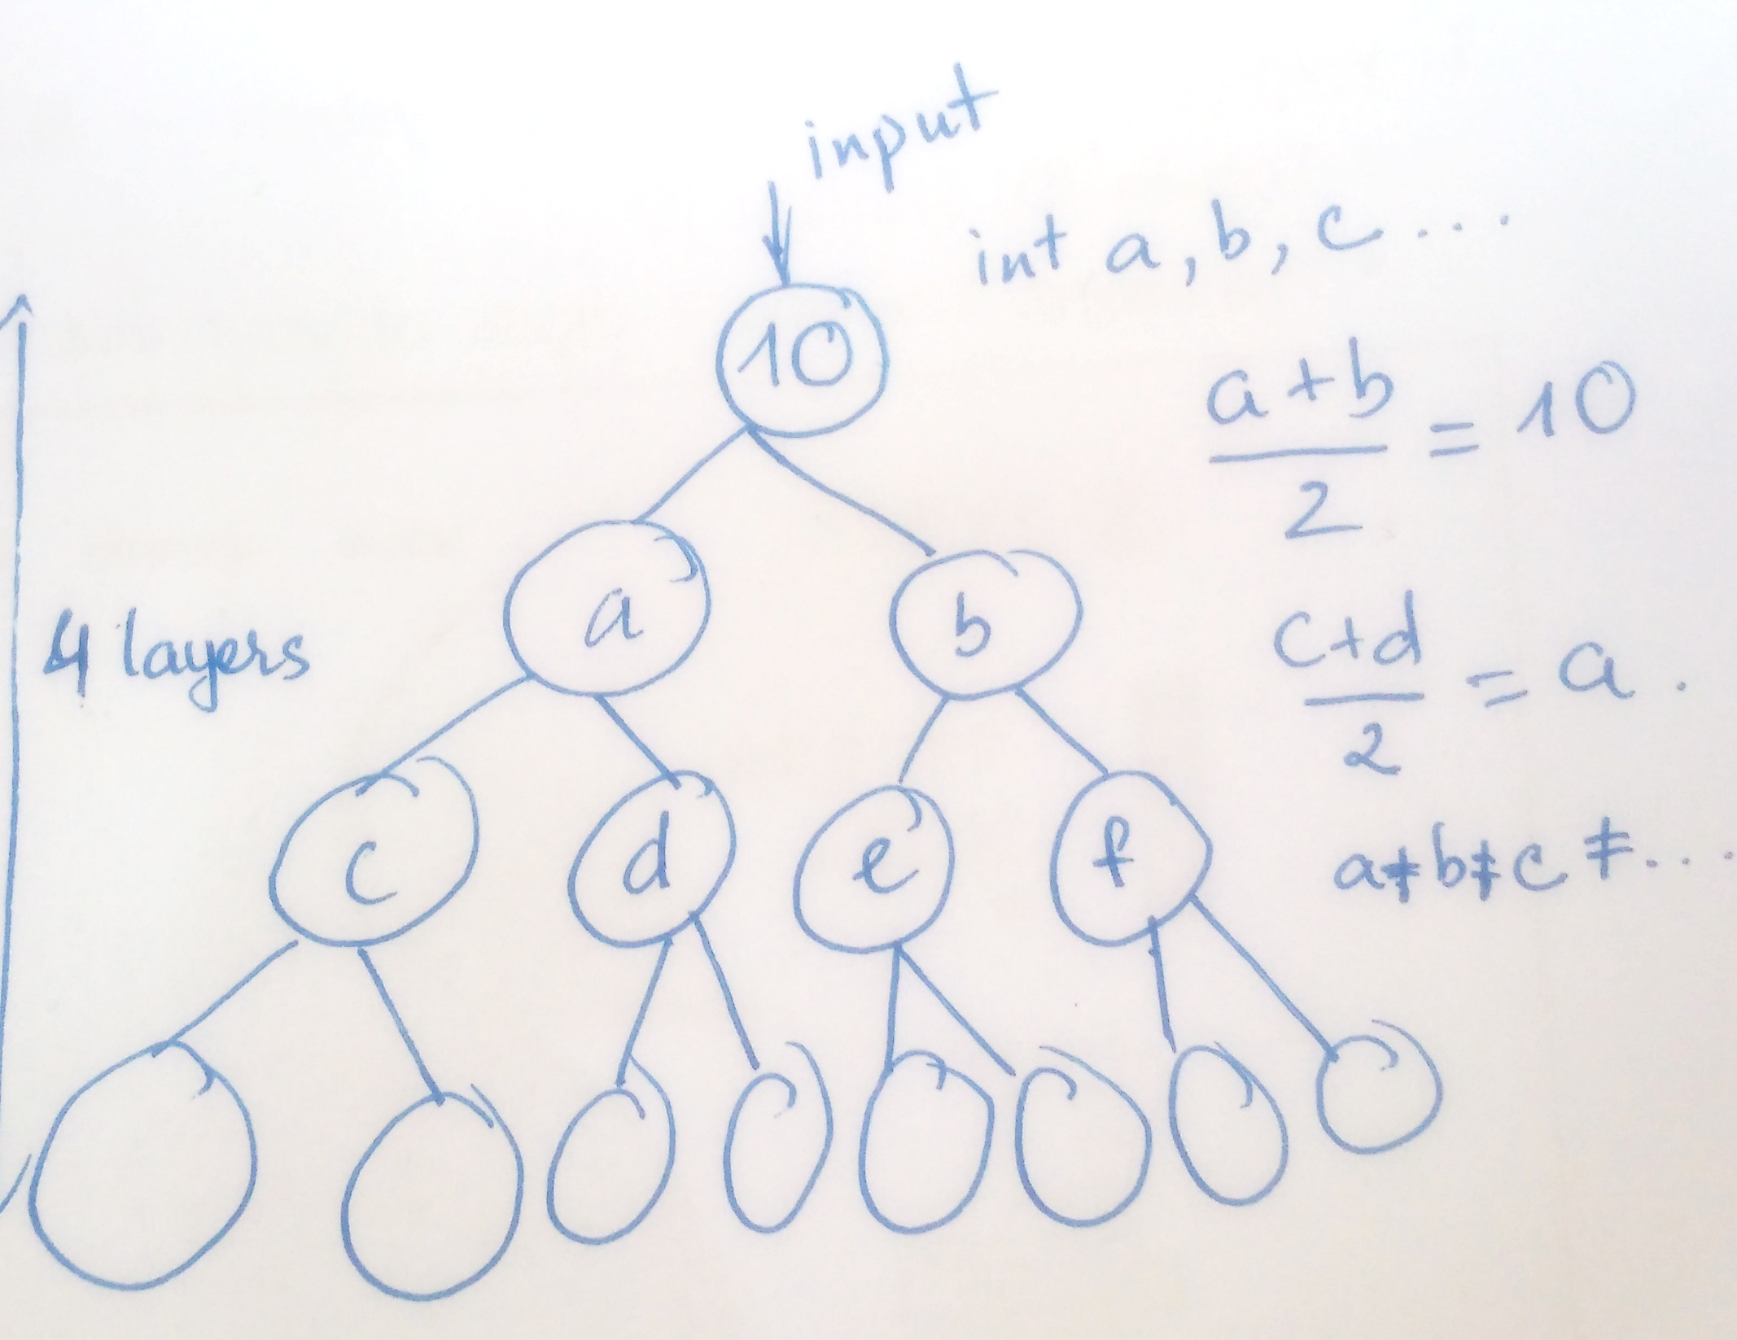
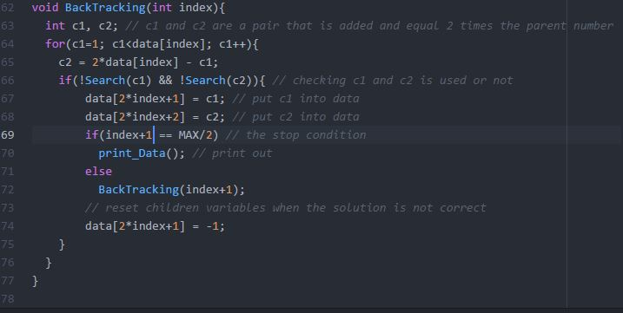
Backtracking algorithm

Slide 12
USD Denominations: 1$, 2$, 5$, 20$, 50$
Using above USD denominations that is used only 10 times to have 100$. Find all solutions ☺

Slide 13
Next 2 weeks
Build system on Rasp pi 3
How to get useful and reliable signals and analysis them

Slide 14
Thank you!

